Slide 1

Binary Notation
Done by: Aysha Vaccaro

Slide 2

Table of Content
What is Binary Notation ,Example of binary notation.
Pictures of binary notation
Binary to base ten conversion
Examples of base ten conversion
Binary addition.
Example of binary addition.

Slide 3
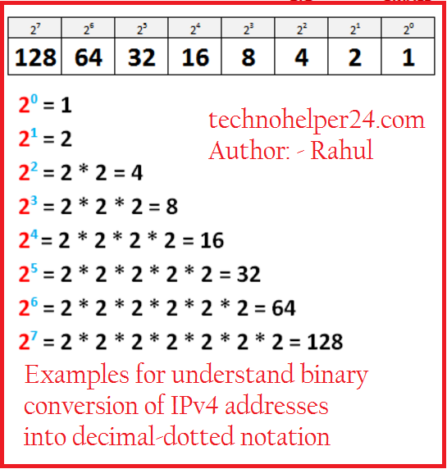
What is Binary Notation and examples.
Binary Notation- expression of a number with a base of 2 using only the digits 0 and 1 with each digital place representing a power of 2 instead of a power of 10 as in decimal notation.
For example, the binary number 100101 is converted to decimal form as follows: 100101₂ = [ ( 1 ) × 2⁵ ] + [ ( 0 ) × 2⁴ ] + [ ( 0 ) × 2³ ] + [ ( 1 ) × 2² ] + [ ( 0 ) × 2¹ ] + [ ( 1 ) × 2⁰ ]

Slide 4
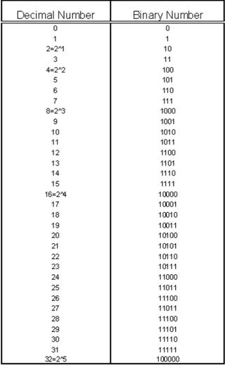
Example of Binary Numbers

Slide 5
Binary to base ten conversion
Each 0 or 1 in a binary number corresponds to a power of 2 depending on its position. For the number you entered, i.e. 101110 this means the 0s and 1s correspond to the following powers of two:
101110 -> 1 x 2^5 + 0 x 2^4 + 1 x 2^3 + 1 x 2^2 + 1 x 2^1 + 0 x 2^0 = 46, or 101110 -> 1 x 32 + 0 x 16 + 1 x 8 + 1 x 4 + 1 x 2 + 0 x 1 = 46, or 101110 -> 46
101110 (base 2) converted to base 10 is therefore: 46
binary number | 1 | 0 | 1 | 1 | 1 | 0
Power of 2 | 5 | 4 | 3 | 2 | 1 | 0

Slide 6
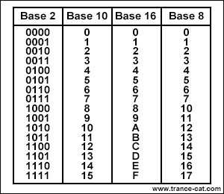
Chart of different binary bases

Slide 7
Binary addition
Binary addition is much like your normal everyday addition (decimal addition), except that it carries on a value of 2 instead of a value of 10. For example: in decimal addition, if you add 8 + 2 you get ten, which you write as 10; in the sum this gives a digit 0 and a carry of 1.
It is a key for binary subtraction, multiplication, division. There are four rules of binary addition. In fourth case, a binary addition is creating a sum of (1 + 1 = 10) i.e. 0 is written in the given column and a carry of 1 over to the next column.

Slide 8
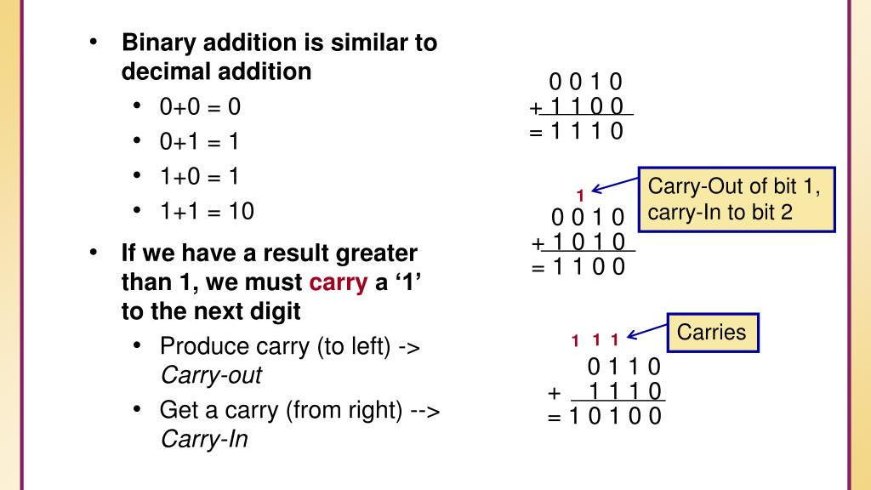

Slide 9
That concludes my presentation thanks for taking out the time to view.

